Slide 1
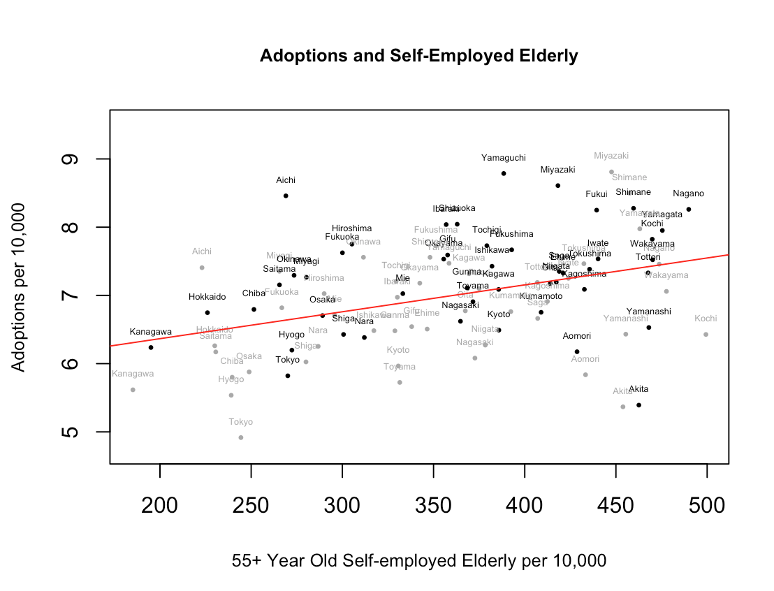
The Economics of Adult Adoption in Japan Morris Reeves, Advisor: Steven Nafziger – May 2018 – Department of Economics, Williams College
Motivation
Variation in Adoption Rates
Adoptions and the Elderly
Why are so many adults adopted in Japan?
Over 35% of the 31,275 adoptions in Japan between January and April of 2010 were of adults, defined as those twenty years old or above in Japan.¹ In contrast, adult adoption is infrequent in the United States, comprising less than 1% of adoptions.²
While several anthropological, legal, and historical accounts of adult adoption in Japan exist, much of this literature emphasizes the importance of the family line and kinship in Japan. The persistence of adult adoption in postwar Japan in the face of changing social attitudes, urbanization, and rapid economic growth raises the question of whether adult adoption has persisted in spite of, or because of, its purported traditionalism.
I explore why adopters and adult adoptees choose to voluntarily enter adoptive relationships through a framework that describes the demand and supply of adoption as endogenous to economic conditions. This economic perspective is increasingly relevant as changes in the way heirs are taxed have taken place in Japan in recent years, including the 1988 Inheritance Tax Act and the 2013 Tax Reform, and as cases of fraud involving adult adoption have subjected the purpose of adult adoption to greater scrutiny.³
Adoptions per 10,000 people (2012)
Adoptions and the Self-employed Elderly (2007, 2012)
Conceptual Framework
Comparative History
The economic literature on multigenerational coresidence, bequest motives, and elderly care in Japan elucidates factors that affect the role of successors and adult children in relation to their parents:
high but declining rate of multigenerational coresidence
a strong, “strategic” bequest motive (bequests conditional on child behavior)
unequal bequest division, partly based on if child provides elderly care⁷
inheritance tax deductions that increase in the number of heirs⁸
The intergenerational transmission of property and employment in exchange for care in old age, as seen in the U.S. in the mid-1800s, conceivably diminishes as employment opportunities and elderly care outside the household increase.
Empirical Results
Is adult adoption unique to Japan?
Adult adoption was officially recognized in Japan at least as early as the seventeenth century; coresident heirs played an important economic role in the household for farm and fishing labor, continued access to samurai stipends, and managerial roles in merchant families.⁴ Yet the primary purpose of adoption in ancient Rome, France, and Germany was similarly for heirs. Adult adoption was formally legalized and acknowledged prior to full child adoption in several Western European countries, including France (1804), and Italy (1865). Similarly, in the U.S., child adoption gained broad social acceptance only in the late 1940s.⁵
How has the adult adoption rate changed over time?
The adult adoption rate is not as high as the 98% figure cited in the majority of news articles on adult adoption in Japan; available statistics on the adult adoption rate from Yamahata (1957), Tanaka and Miura (1983) and the Ministry of Justice (2010) suggest that the adult adoption rate in Japan has declined from 67% of all adoptions to 38% since the 1980s.⁶ The 98% figure cited is the proportion of adoptions which do not require the permission of the family court, but this includes adoptions of related descendants who are minors.
The number of self-employed elderly people per 10,000 is positively and significantly associated with the number of adoptions per 10,000 people, while the number of elderly is not significant, consistent with the hypothesis that the economic basis of the family influences adoption decisions.
Similarly, in a separate regression not shown, I find that the number of small businesses (5-9 employees) per household is positively and significantly associated with adoptions per household.
The Market for Adult Adoption
“Price”:
Expected
Bequest
Supply
Employment opportunities outside household
Elasticity: altruism and social norms
S
Demand
Inheritance taxation
Public pensions and nursing care
Self-employment
D
Adoptions, Coresidence, and Duties of Heir
Conclusions
These factors motivate the following specification:
Adoptions_{it} = β₁ (Elderly Self-Employed)_{it} + β₂ (High Income)_{it} + β₃ (Elderly
Care Services)_{it} + β₄ (Elderly)_{it} + β₅ (Primary Industry)_{it} + λ_{t} + ε
where Adoptions are total adoptions (including of children) per 10,000 people in prefecture i and year t, Elderly Care Services is the number of occupants of elderly care facilities per 10,000, and Elderly Self-Employed is the number of self-employed 55+ year olds per 10,000, from the Bureau of Statistics.
The practice of adult adoption is not historically unique to Japan; moreover, the apparent decline in adult adoptions since the 1980s coincides with declining multigenerational coresidence and declining numbers of the self-employed as proportions of total employment.⁹ I find that the proportion of the self-employed elderly is significantly and positively associated with adoptions, although the lack of a natural experiment precludes any causal claims.
Estimates of number of adult adoptions based on adult adoption rate
Acknowledgements
I would like to thank my advisor, Professor Nafziger, for providing thoughtful feedback and encouragement throughout the course of this thesis and for introducing me to the field of economic history. I would like to thank Professor Gentry for his helpful comments on the draft. I would also like to thank the Japanese and Asian Studies Department here for guiding and supporting me from reading textbooks in Japanese 201 in freshman year to reading about inheritance tax law in Japan.
References:
1..Ministry of Justice, Yoshi engumi nado ni kansuru jittaichosa kekkagaiyo [Overview of results of survey concerning adoption], 2010.
2. Moriguchi, Chiaki. “Jidoufukushi to shiteno yoshiseido wo kangaeru seinenyoshitaikoku...” HQ, Vol. 36, Oct. 2012, pp. 26-27.
3. Sorimachi, Megumi. “Seinen yoshiengumi no hotekikisei no hitsuyosei ni kansuru ichikosatsu.” Gendai shakai bunka kenkyu no. 37, Dec. 2006, p. 61
4. Paulson, Joy Larsen. Family Law Reform in Postwar Japan: Succession and Adoption. Xlibris Corporation, 2010; p. 168-169;
Moore, Ray A. “Adoption and Samurai Mobility in Tokugawa Japan.” The Journal of Asian Studies, vol. 29, no. 3, 1970, p. 630
References (cont’d):
5. Mignot, Jean-François. “Child Adoption in Western Europe, 1900-2016,” 2018;
Moriguchi, Chiaki. “Child Adoption in Japan, 1948-2008.” Keizai kenkyu, Vol. 61, No. 4, Oct. 2010, p. 342
6.. Yamahata (1977) cited in Paulson (2010), p. 101; Tanaka and Miura (1983), cited in Moriguchi, Chiaki and Enhwa Kang. “Nihon to kankoku ni okeru yoshiseido no hatten to jidofukushi – rekishitokei wo mochiita hikakuseido bunseki no kokoromi.” Hitotsubashi University Discussion Paper Series A, no. 637, February 2016, p. 4
7. Yamashige, Shinji. “Economic Analysis of Families and Society: The Transformation of Japanese Society and Public Policies [Kazoku to shakai no keizaibunseki – nihonshakai no henyo to seisakutekitaio.]” Author’s website, Figure 2.2; Horioka, Charles Yuji, Emin Gahramanov, Aziz Hayat, and Xueli Tang. “Why do Children Take Care of their Elderly Parents? Are the Japanese Any Different?” International Economic Review vol. 59, no. 1, Feb. 2018, p. 113-136.
8. Barthold, Thomas, and Takatoshi Ito. “The Political Economy of Tax Reform.” NBER-EASE, vol. 1, p. 235-293, 1992.
References (cont’d):
9. Bureau, Ministry of Internal Affairs and Communications, Labor Force Survey.

